Slide 1
Course Code: CSC211A Course Title: Formal Languages and Automata Theory
Lecture 24: Negative Properties of CFL
Course Leader:
Prakash P
prakashp.cs.et@msruas.ac.in

Slide 2
Session Objectives
At the end of this session, student will be able
Explain context free languages are not closed under intersection and complement
Describe the intersection of context free language and regular language is a context free language

Slide 3
Session Topics
Context free languages
Intersection of context free language and regular language

Slide 4
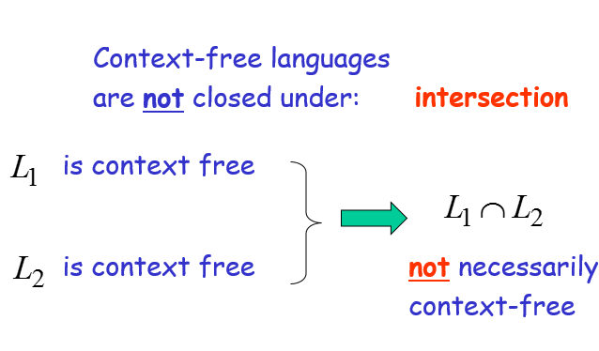
Intersection

Slide 5
Example
Context-free:
Context-free:
Intersection
NOT context-free

Slide 6
Complement
Context-free languages are not closed under:
Complement
is context free
not necessarily
context-free

Slide 7
Example
Context-free:
Context-free:
Complement
NOT context-free

Slide 8
Intersection of Context-free languages and Regular Languages

Slide 9
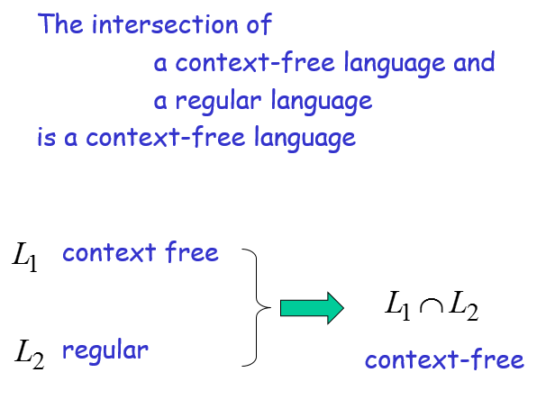
Intersection of CFL and RL

Slide 10
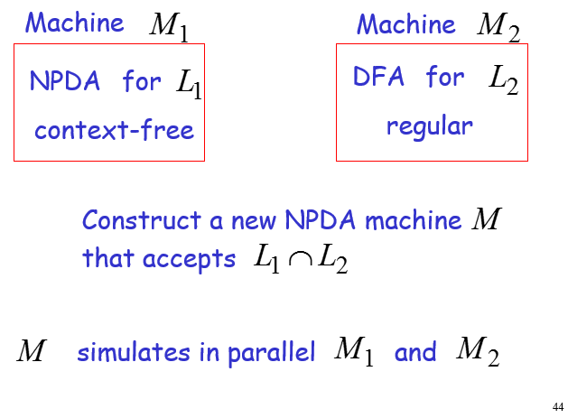
Intersection of CFL and RL

Slide 11
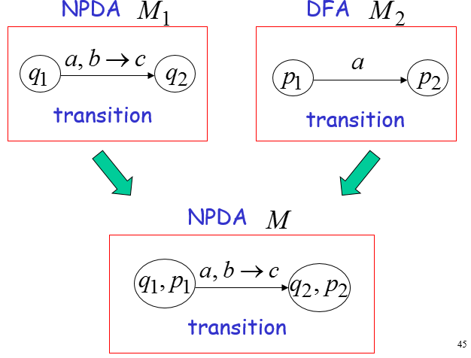
Intersection of CFL and RL

Slide 12
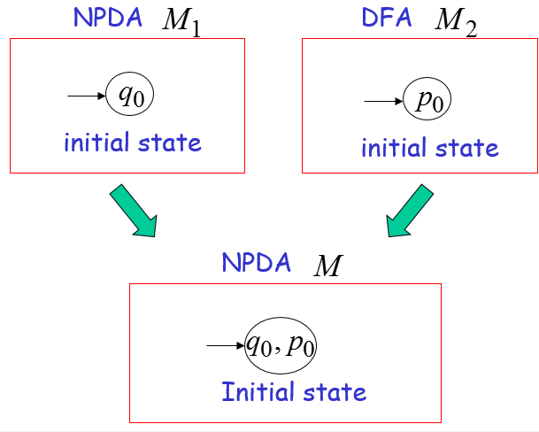
Intersection of CFL and RL

Slide 13
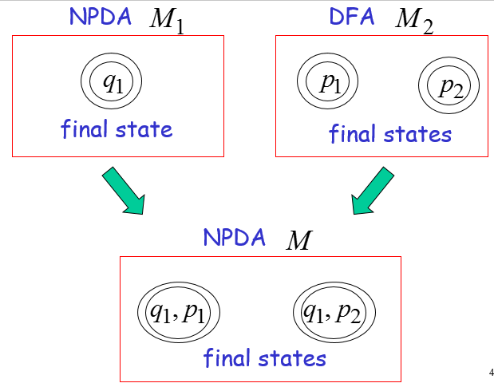
Intersection of CFL and RL

Slide 14
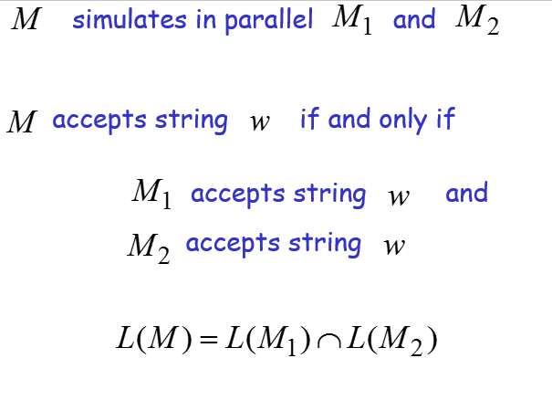
Intersection of CFL and RL

Slide 15
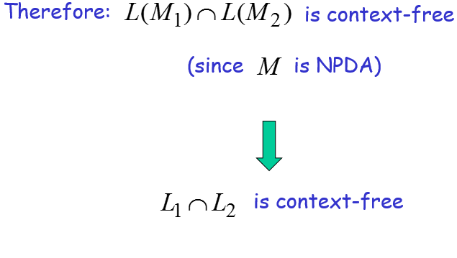
Intersection of CFL and RL

Slide 16
Summary
Context free languages are not closed under intersection and complement
The intersection of context free language and regular language is a context free language

